Slide 1

Capstone project 1
Mayank
Tanmay
Bhavesh
Ashish
Chandana
Mugundhan

Slide 2



2 Tasks
Python
SQL

Slide 3
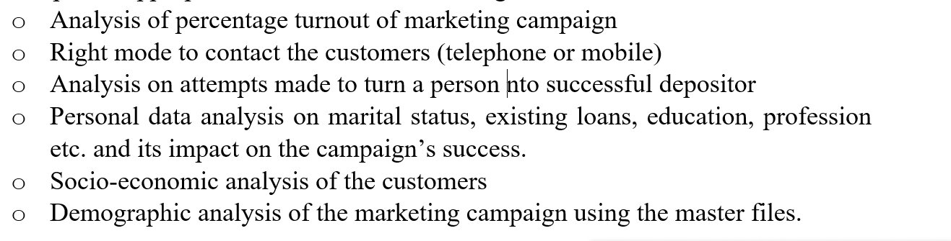
6 Sub tasks in python
6 members
Mayank 4
Tanmay 3
Ashish 1
Chandana 5
Muku 2
Bhavesh 6

Slide 4

SQL
Stage 1 --------3 members
Stage 2 --------3 members

Slide 5
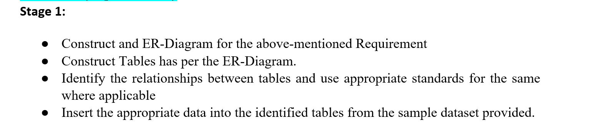
Stage 1 by wednesday
Ashish
Mayank
Tanmay

Slide 6
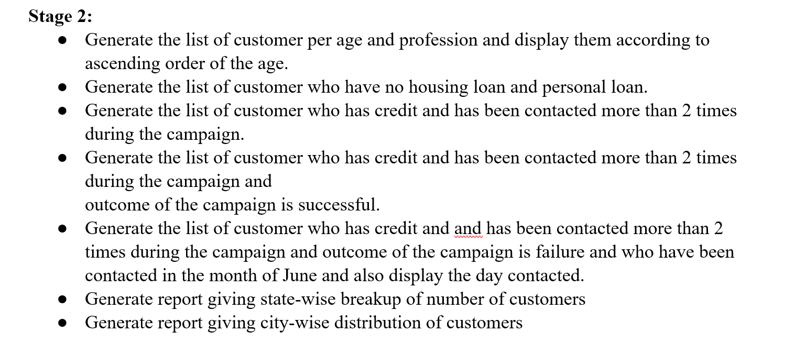
Stage 2 by thursday
Muku
Bhavesh
Chandana

Slide 7
Guidelines
You have to prepare a power point presentation with screenshots of outputs (10 -15 slides) for each check point
Mention Problem Statement and Your approach to the problems
You need to submit all the code files - Task 1.1
The code file(html file for Task 1.1) should contain the Batch Name and the group name, group members (One of the group member) at the top (in Jupyter Notebook).
All comments/inferences/insights/reasons for doing a particular tasks etc should be written as a ‘markdown text’, but NOT using a comment lines with # or ‘’’.
Submit the code file as HTML file format (you have an option in Jupyter Notebook to save the file as HTML).
Name of the file must be in the form of:
BatchName_FirstName_SecondName.html
Task 1.2 SQL code to be copied in the word doc
The presentation file should have the Batch name, group name, Project name, Group members, their responsibilities
Upload all the deliverables in the UNext LMS

Slide 8


Thank You
Presenter name
Email address
Website address

